Slide 1
Hand gesture in presentation
Shijie Zhang

Slide 2
Outline
Why gestures?
Prepare yourself for gestures in virtual meeting
Interesting gestures in meetings
Number listing
Leveling
Contrast
Prompting
Holds - Clasp
Holds - Figure cage
Interlace
Summary

Slide 3
Outline
Why gestures?
Prepare yourself for gestures in virtual meeting
Interesting gestures in meetings
Number listing
Leveling
Contrast
Prompting
Holds - Clasp
Holds - Figure cage
Interlace
Summary

Slide 4
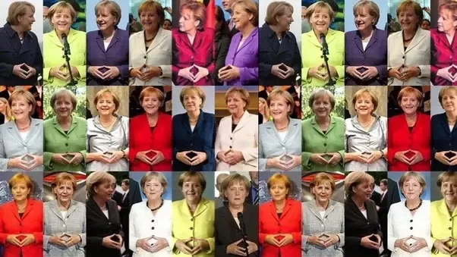
Merkel gesture - An example for not using gestures

Slide 5
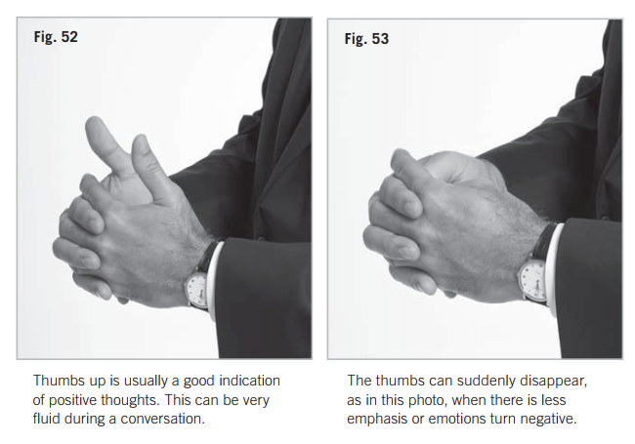
Expressive hands

Slide 6
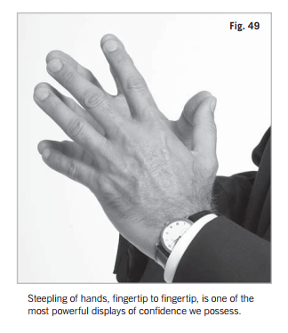
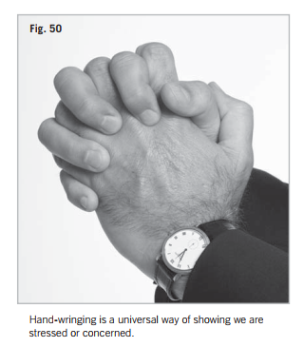
Expressive hands

Slide 7
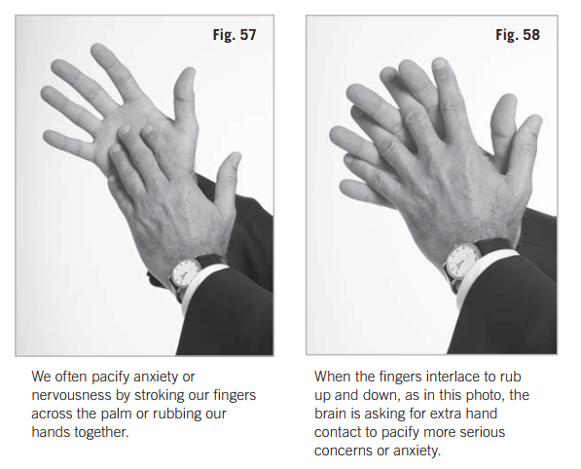
Expressive hands

Slide 8
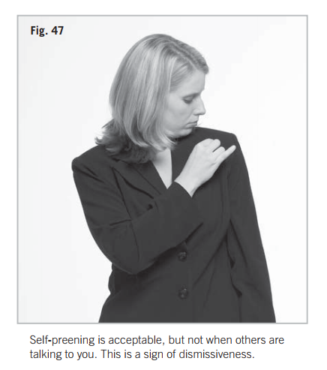
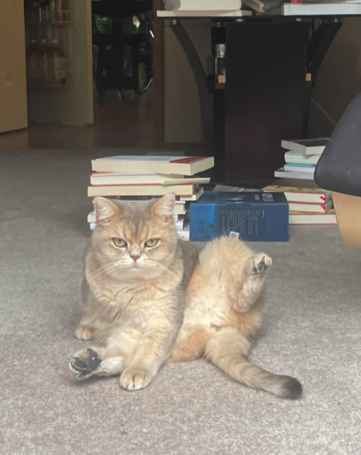
Expressive hands

Slide 9
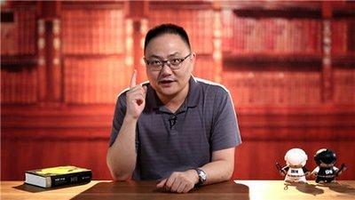
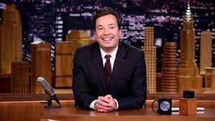
Hand gestures in talk shows
Least popular public speaker uses 272 hand gestures in 18 minute talk.
Most popular public speaker uses 465 hand gestures in 18 minute talk.

Slide 10
Gesture categories
Why gestures?
Prepare yourself for gestures in virtual meeting
Interesting gestures in meetings
Number listing
Leveling
Contrast
Prompting
Holds - Clasp
Holds - Figure cage
Interlace
Summary

Slide 11
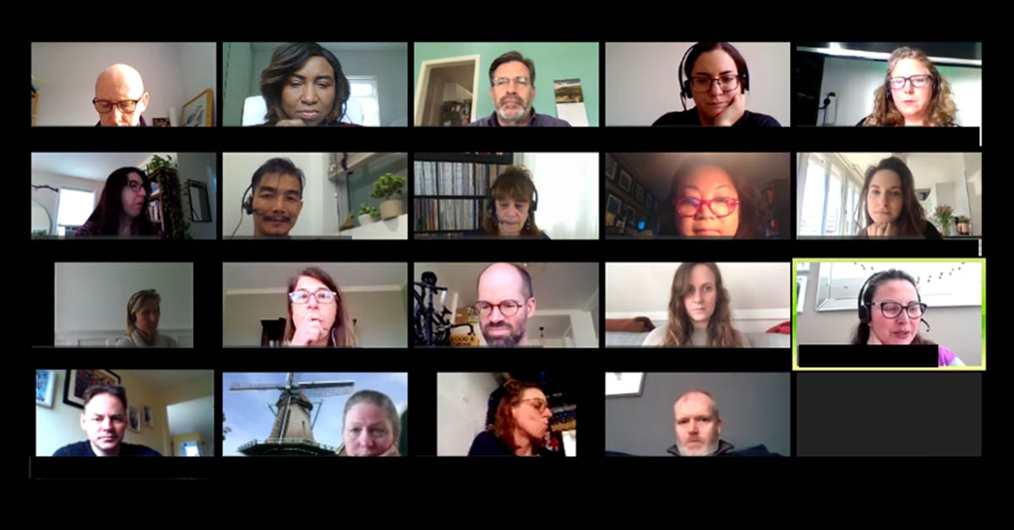
No gestures in meeting ?

Slide 12
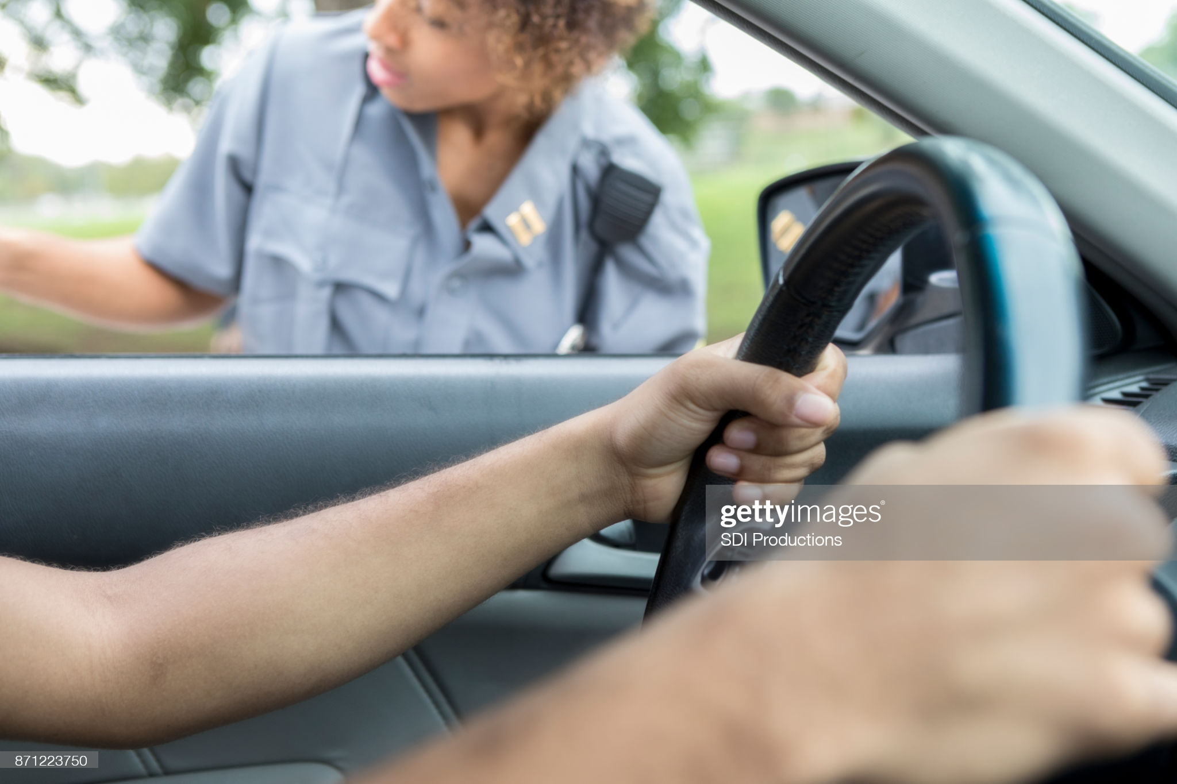
Hands on wheels

Slide 13
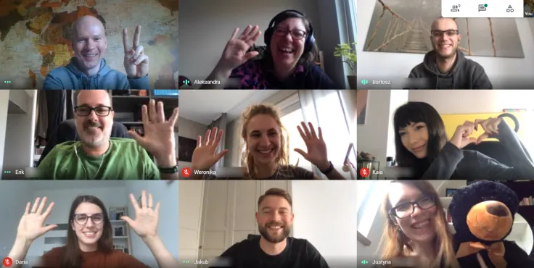
Correct position for meeting

Slide 14
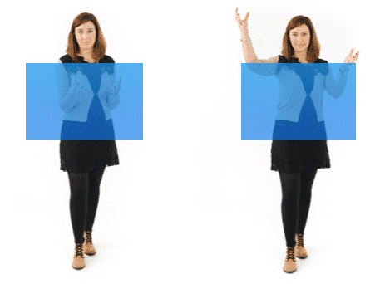
Find your setup
Common reasons people don’t use gestures
Camera - Laptop camera / Too close to camera
Need a better microphone
Don’t know what to do with gestures
Find your setup
For me
Stand-up and distance
Airpod

Slide 15
Outline
Why gestures?
Prepare yourself for gestures in virtual meeting
Interesting gestures in presentations
Number listing
Leveling
Contrast
Prompting
Holds - Clasp
Holds - Figure cage
Interlace
Summary

Slide 16
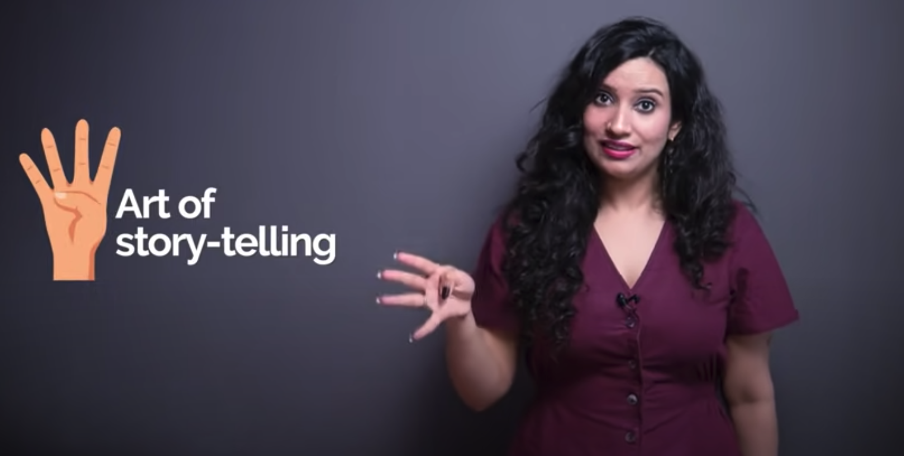
Number listing
Listing

Slide 17
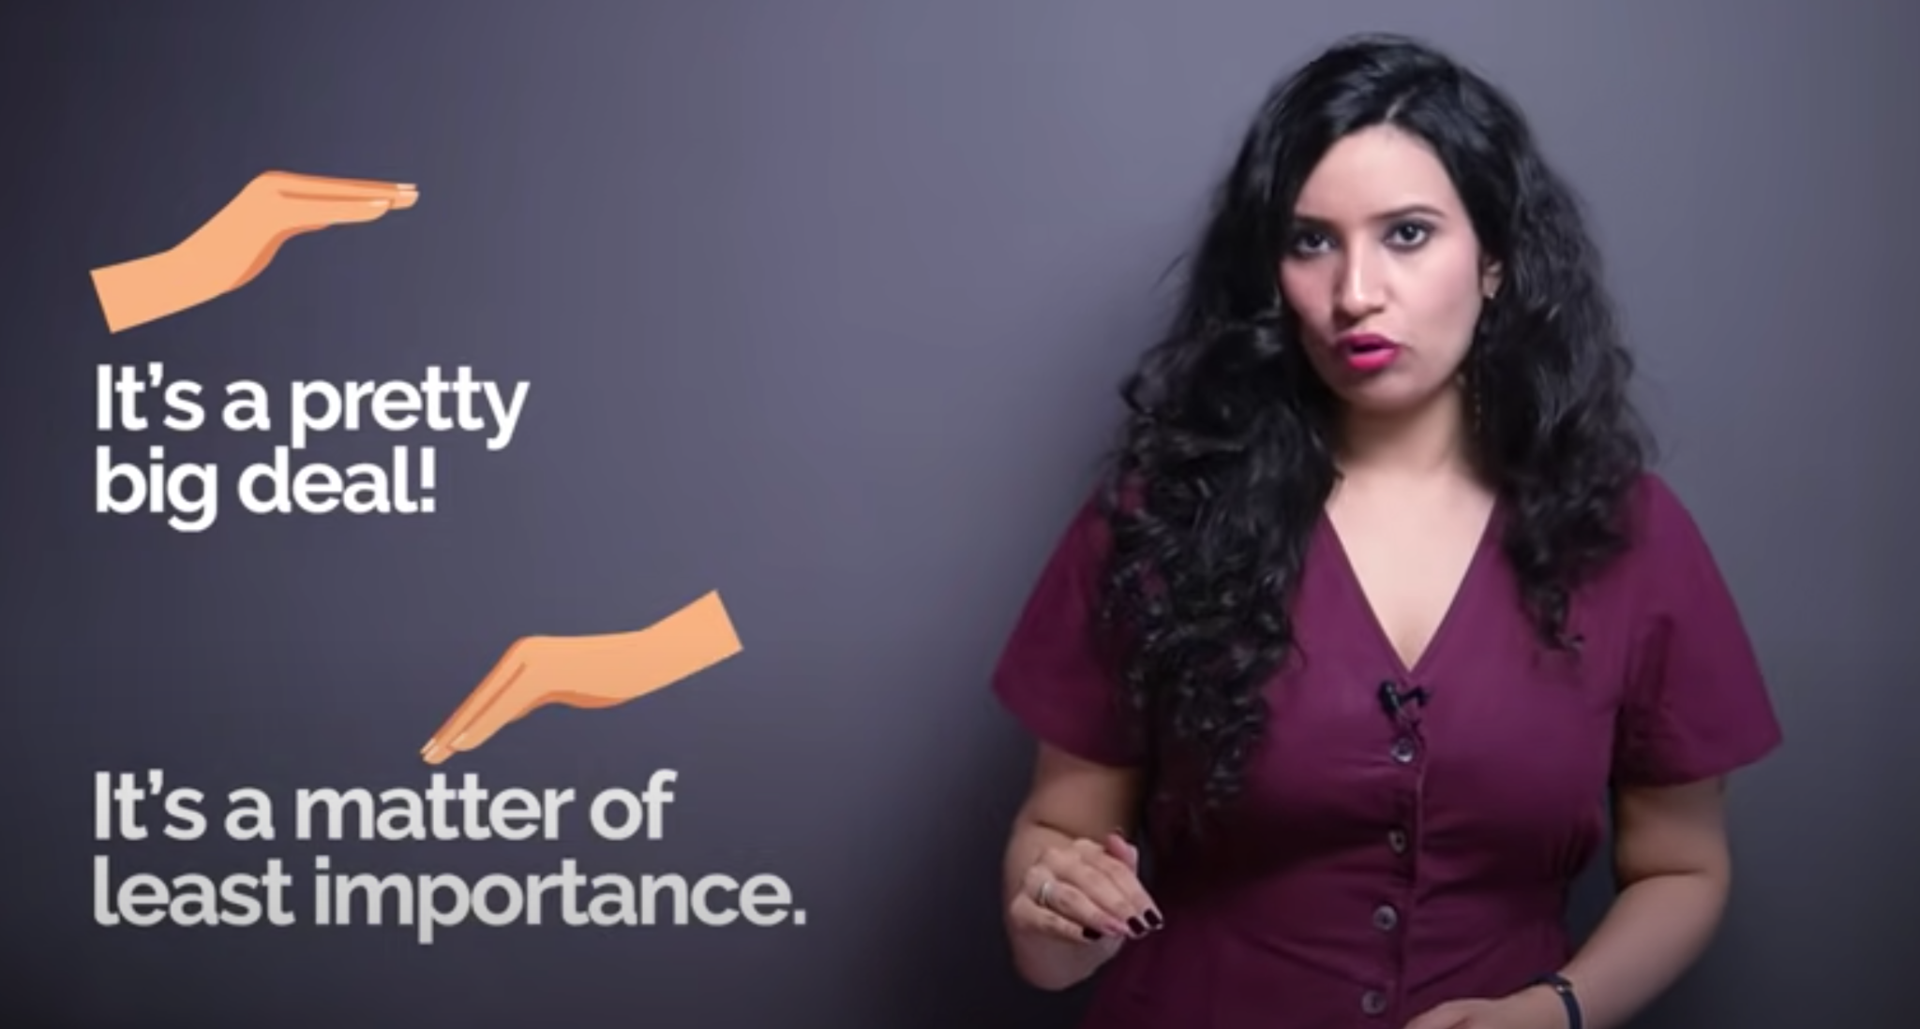
Leveling - Up/Down

Slide 18
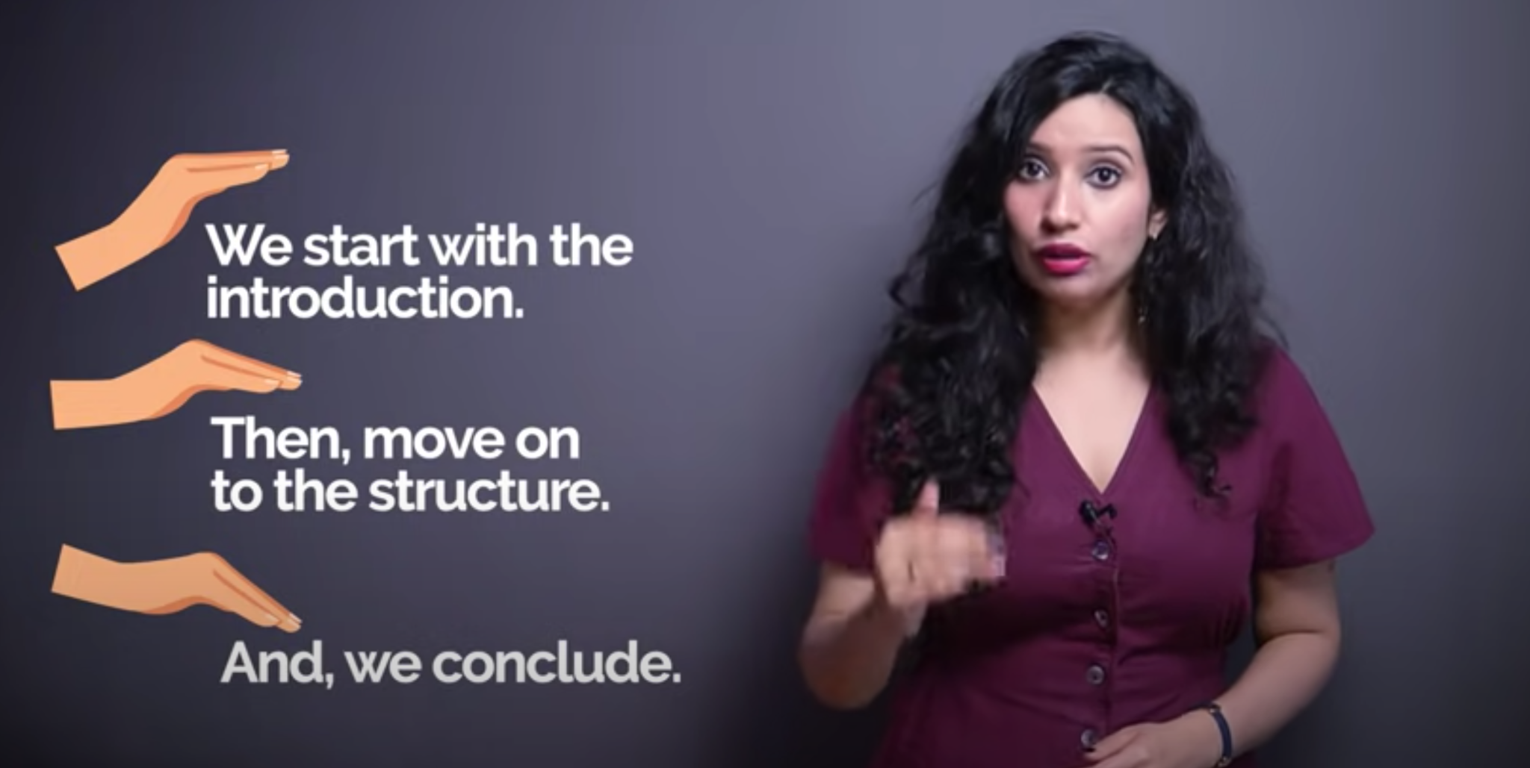
Leveling - Alternative to listing

Slide 19
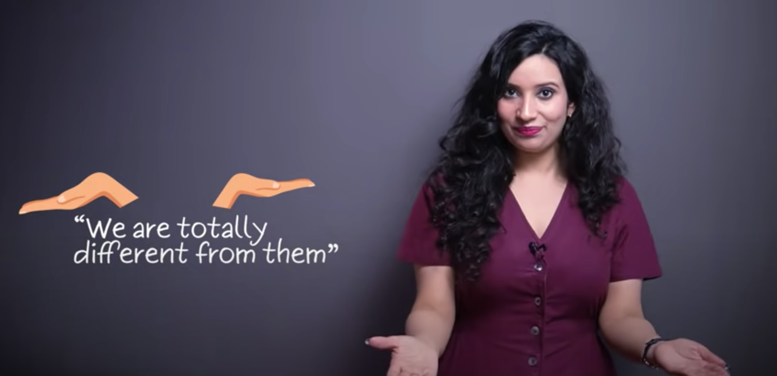
Contrast - Show two different things

Slide 20
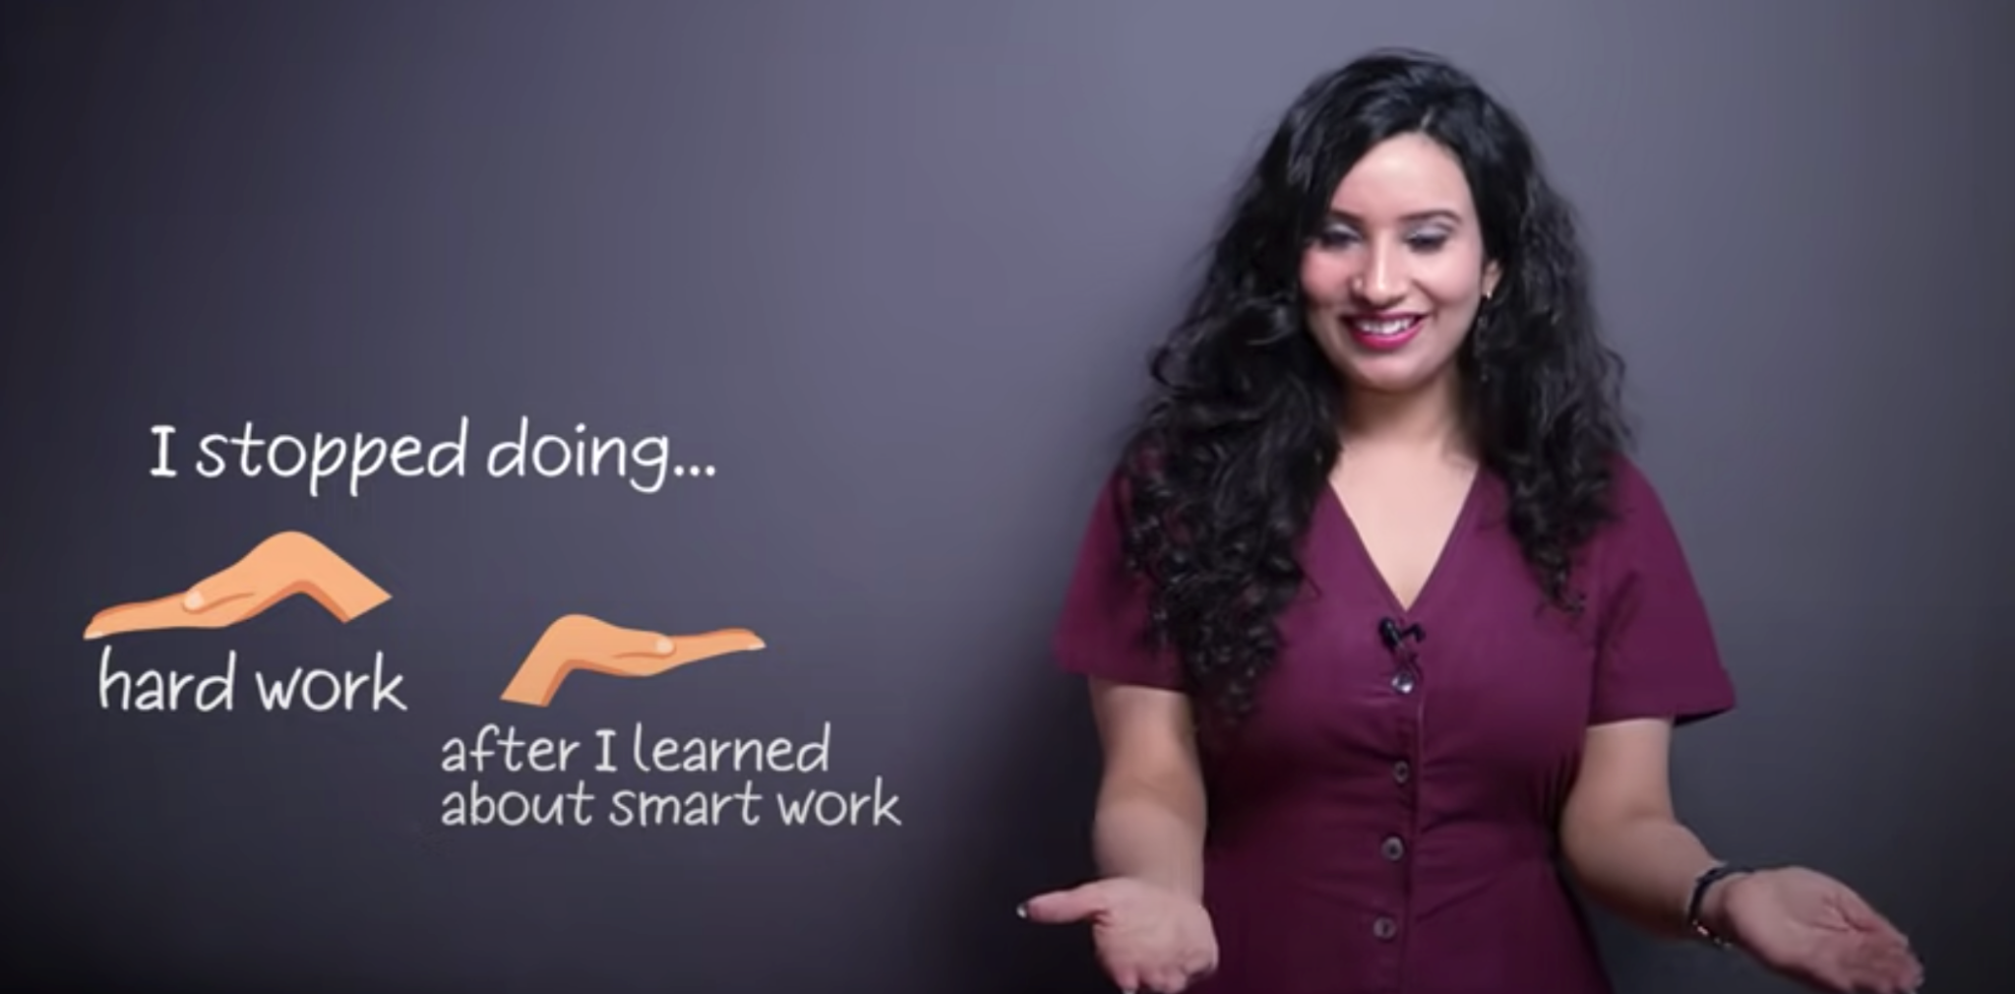
Contrast - Show a change

Slide 21
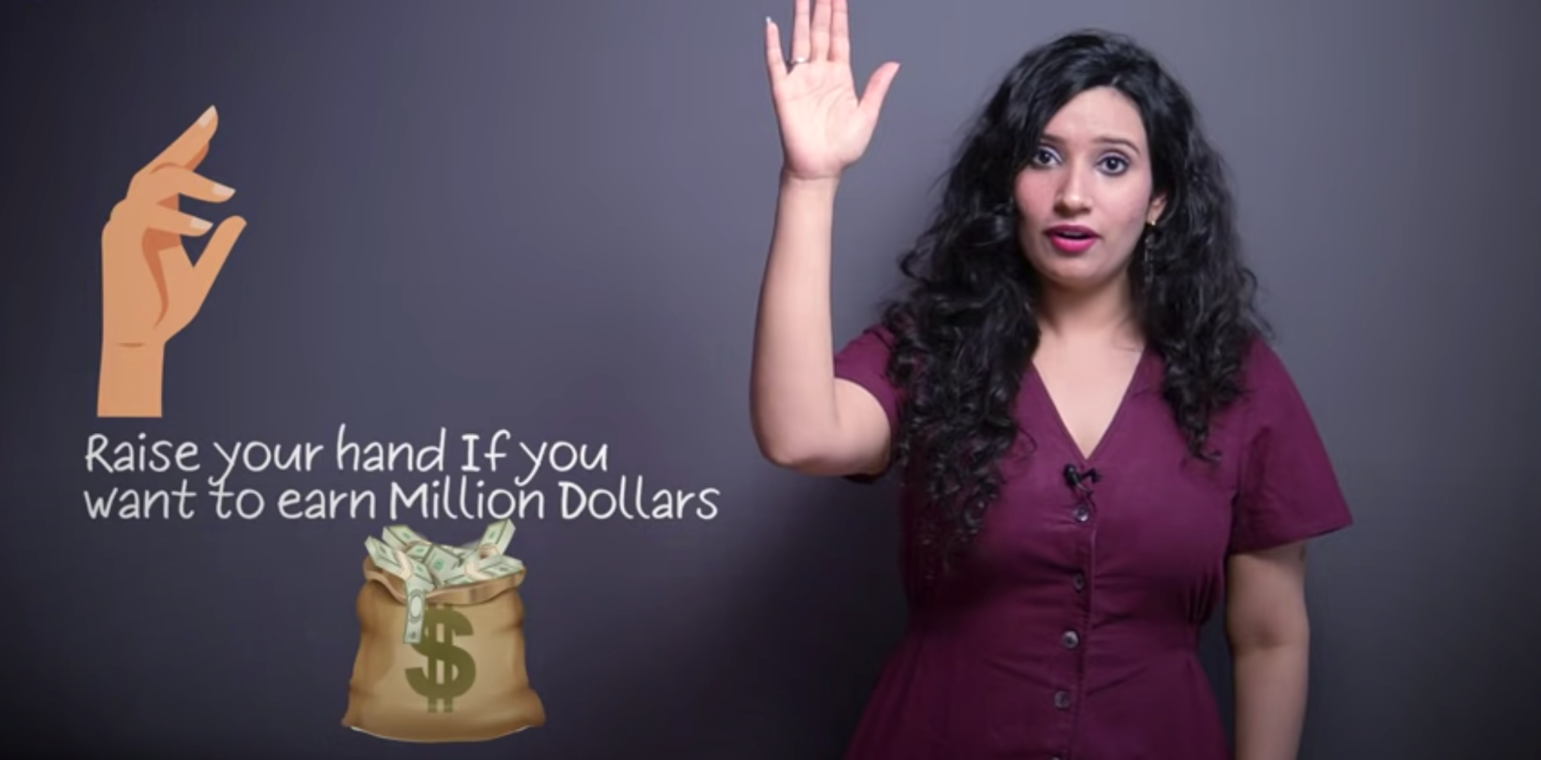
Raise your hands - Speaker and listener do together

Slide 22
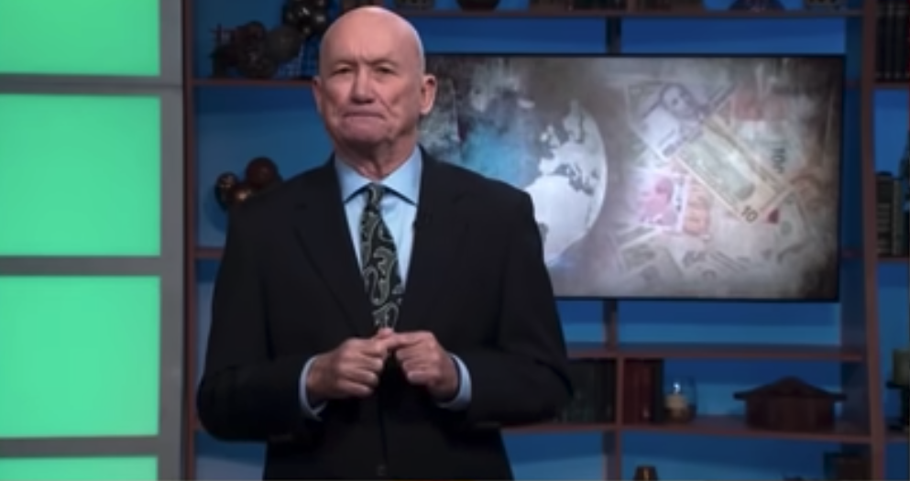
Figure prison - Talk about one point later

Slide 23
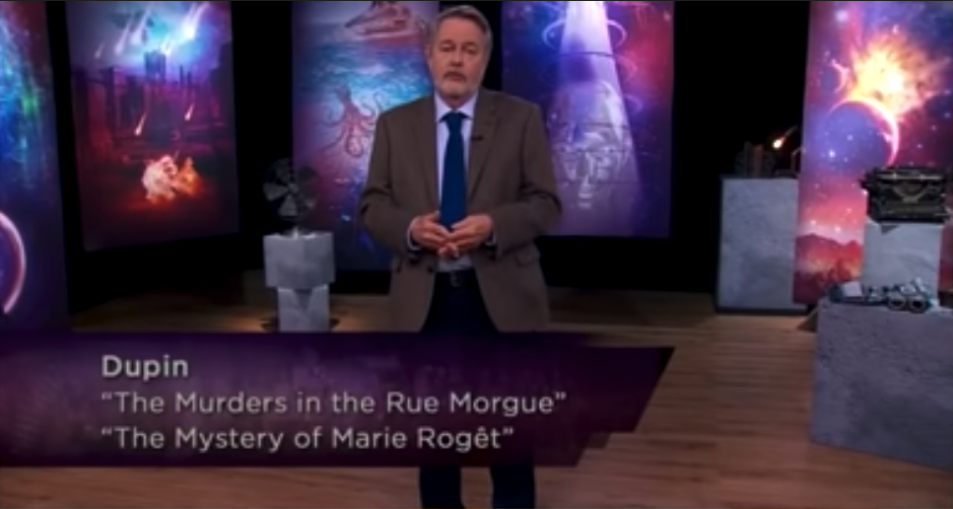
Interlace - Talking about details

Slide 24
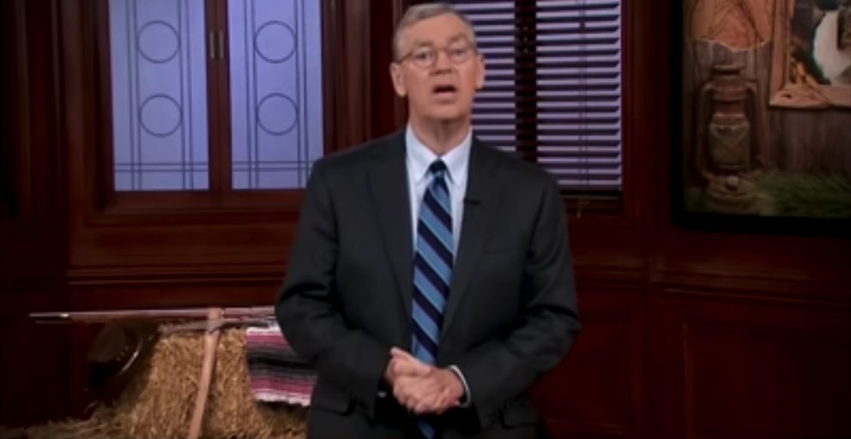
Clasp gesture - Conclusion

Slide 25
Gesture outline
Why gestures?
Prepare yourself for gestures in virtual meeting
Interesting gestures in meetings
Number listing
Leveling
Contrast
Raise your hands
Holds - Figure cage
Interlace
Holds - Clasp
Summary

Slide 26
Summary
Doing nothing gesture - Merkel gesture
Even if you don’t plan to use much hand gestures, never a bad idea to build your trademarks by doing nothing
Find your setup for gestures
Many interesting gestures
Numbers - Listing
Structure/Importance - Leveling
Comparison - Contrasting
Interacting with audience - Prompting
One important point later - Figure prison
Diving into details - Interlace
Conclusion - Clasp

Slide 27
References
https://www.youtube.com/watch?v=3yYjYvdcCw8&ab_channel=Skillopedia-Skillsfortherealworld
https://www.youtube.com/watch?v=zn2iRG7bI2I&ab_channel=VanessaVanEdwards
https://www.youtube.com/watch?v=xY_xiGadcgk&ab_channel=EnglishwithEmma%C2%B7engVid
https://www.youtube.com/watch?v=gpqfZJuZRNY&ab_channel=Lindybeige

